Slide 1
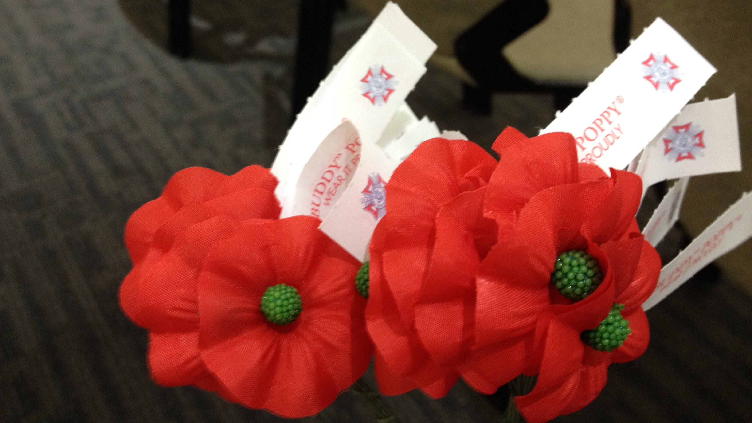

Supporting Our Veterans & Families
Buddy Poppy • VFW National Home
By Florida Dept. Chairman
Jennifer Holland
jenniferLholland72@comcast.net

Slide 2
Reminder: Why These Programs Matter
Buddy Poppy donations support veterans and their families.
VFW National Home assists Military, Veterans and their families by creating stability, providing housing, education & resources.
Every Auxiliary effort makes a direct impact!

Slide 3

Department of Florida Awards:
Special Award for Most outstanding in each membership class activity and/or event with their VFW Post to educate their community about the VFW "Buddy”® Poppy.
Special Award in each membership class for Most outstanding activity and/or event that creates awareness and education of eligibility and who qualifies for help from the VFW National Home and promoting it within their Department to help veterans and their families .
One special award per membership class that hosted or participated in the most "Buddy” Poppy distribution drives within the community. (Must also submit pictures to Dept. Chair)
Certificates to all Auxiliaries who promote and donated to Commander in Chief Whitmore & National President Callahan’s, Whitmore’s Warriors, "Let’s Do More Stock the Store” for VFW National Home Retail Store. (Must submit proof of donation)

Slide 4
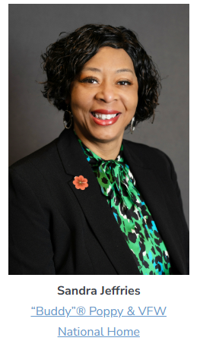
National Awards:
Most outstanding activity and/or event with their VFW Post to educate their community about the VFW "Buddy”® Poppy.
Most outstanding activity and/or event that creates awareness and education of eligibility and who qualifies for help from the VFW National Home and promoting it within their Department to help veterans and their families.

Slide 5
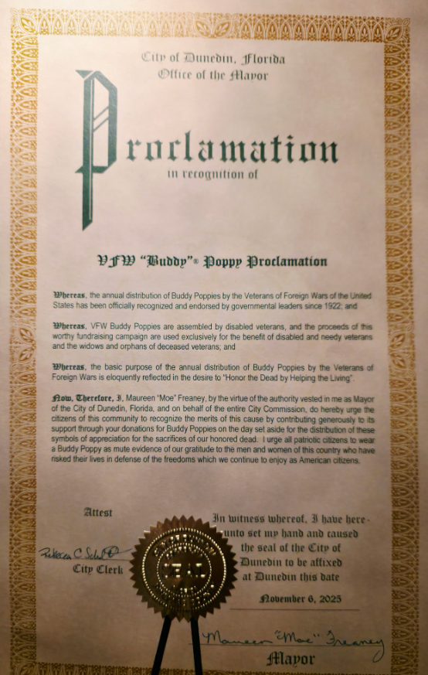
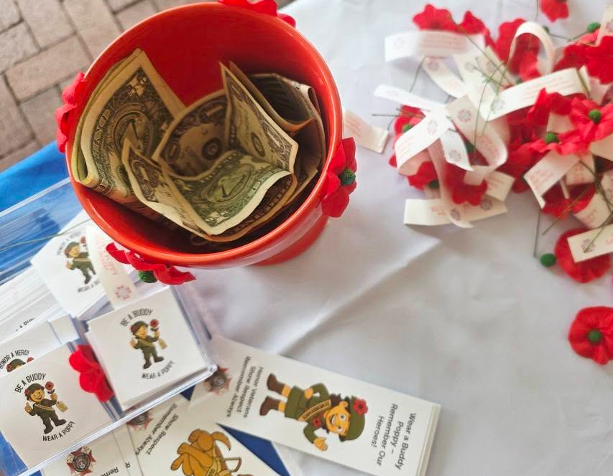
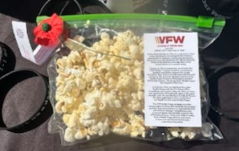
Dept. of FL Auxiliaries & VFW Posts in Action
Buddy Poppy

Slide 6
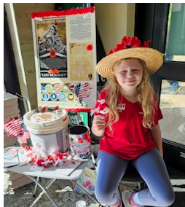

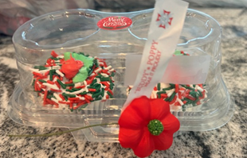
Dept. of FL Auxiliaries with their & VFW Posts in Action
Buddy Poppy

Slide 7

Supporting the VFW National Home
Monetary donations support Veteran families and children
Awareness is just as important as fundraising
Educate the National Home story with your community
Purchase a Tribute Brick
Join as a Lifetime Member for only $100
Home Front Hero-Give Monthly

Slide 8

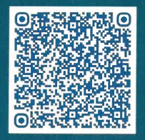
Let’s Do More: Stock The Store
Currently NO Reports on this Project
VFW National Home

Slide 9

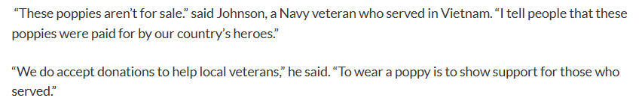
Tips & Deadlines
Buddy Poppy’s are NOT for SALE!!
Any money donated for Buddy Poppies go into your relief fund!
All Buddy Poppy & National Home reports must be entered in MALTA by April 15, 2026

Slide 10
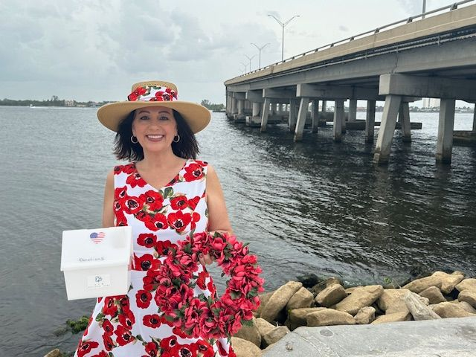
THANK YOU, Dept. of FL Auxiliaries! You are amazing keep up the great WORK!! REPORT REPORT REPORT!
Any Questions please reach out:
Jennifer Holland
jenniferLholland72@comcast.net
484-574-2886

